Slide 1

BDM CAPSTONE PROJECT JUNE 2023 Optimizing Job Workflow and Skilled Labor Availability for Increased Manufacturing Business Profitability
KALPANA SUBRAMANI
22dS1000264

Slide 2
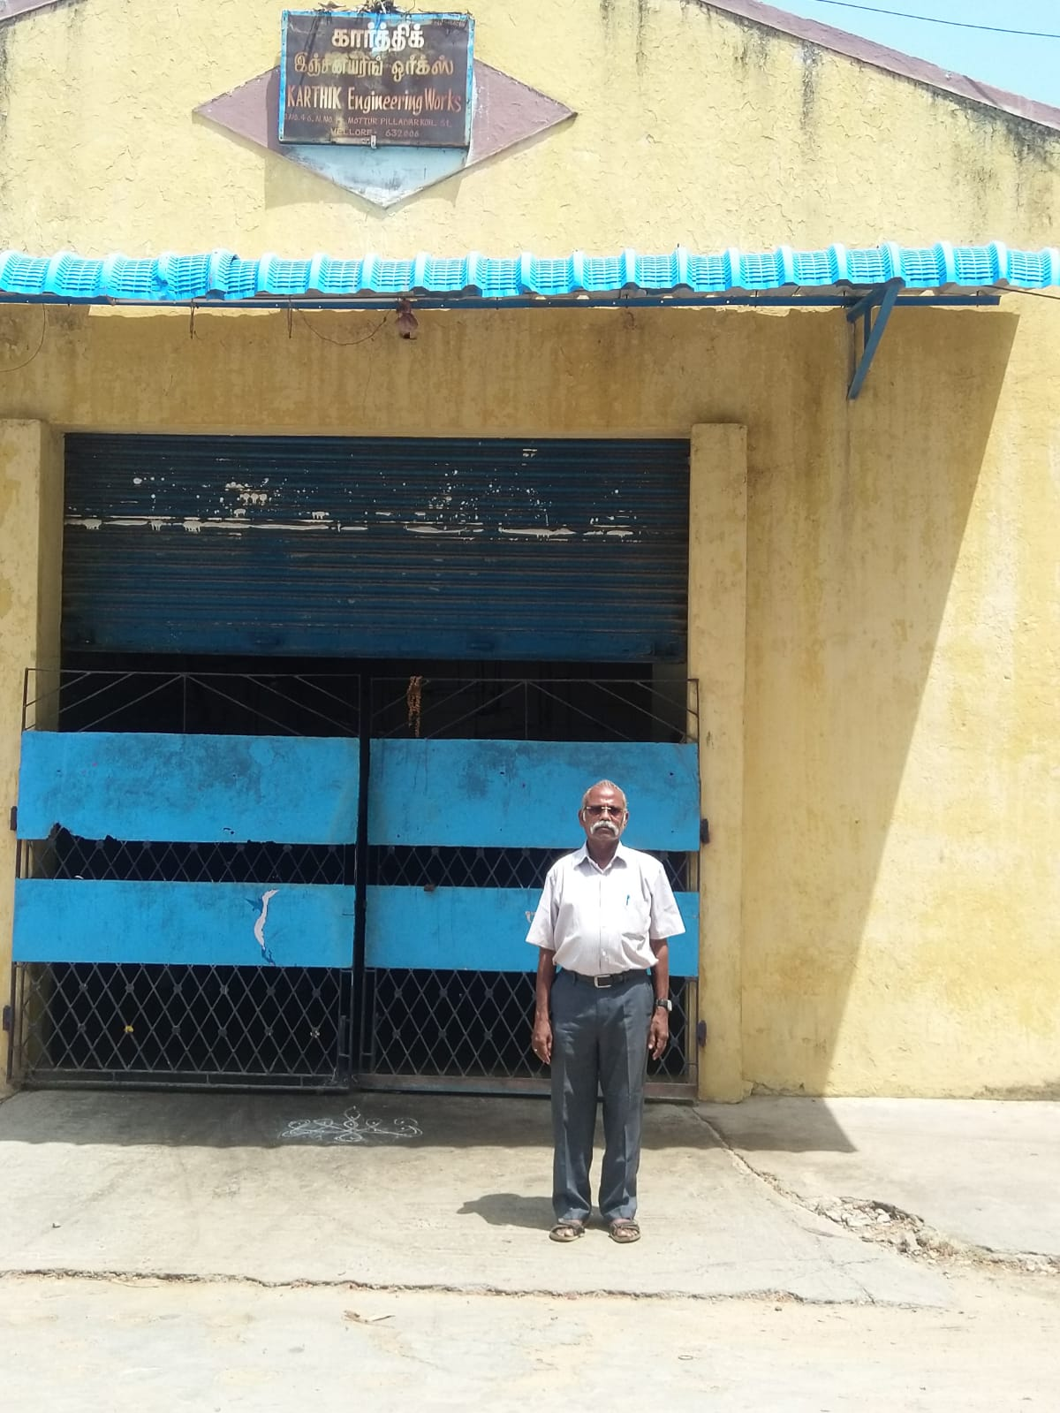
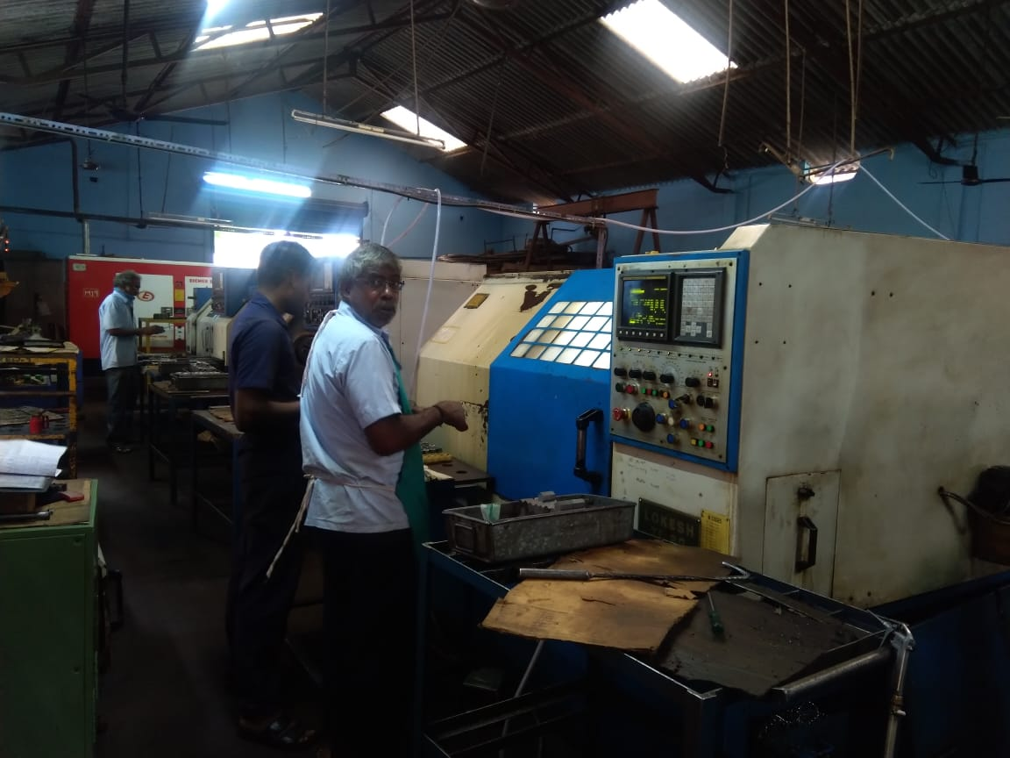
ORGANIZATION BACKGROUND OF KARTHIK ENGINEERING WORKS
Engineering Works is a reputable small-scale manufacturing industry situated in Vellore, Tamil Nadu.
Founded in April 1996 by Subramani Parasuraman.
Specializing in the production of precision-machined auto components, the company offers a range of engineering services, including the manufacturing of various tractor spares such as adaptor plugs, adaptor blocks, M18 plugs, M14 plugs, M16 plugs, 3/8th plugs, Bushes and turboshafts.
The company utilizes advanced technologies and tools to ensure the delivery of high-quality engineering solutions to its customers.
Known for its reliability, exceptional quality, and prompt service.

Slide 3



PROBLEMS FACED BY THE COMPANY
Fluctuating Revenue and Reduced Profitability: Inconsistent job workflow leads to revenue fluctuations.
Impact of Transportation Costs on Pricing: Acquiring job work from cities poses challenges due to added transport costs.
Scarcity of Skilled Workers: The scarcity of workers or skilled workers is a challenge faced by the industry due to a lack of individuals with the necessary expertise and qualifications.
Employee Turnover and Lack of Ownership: The industry further faces challenges stemming from a lack of employee involvement and ownership.
TALK TO THE CLIENT
VISIT THE KARTHIK ENGINEERING WORKS MANUFACTURING UNIT
EVALUATE & GIVE SUGGESSIONS

Slide 4
OBJECTIVES TACKLING THE PROBLEM
Analysis Methods
Distance Factor Analysis
Temporal Analysis
Employee Attrition Analysis
To tackle this issue of inconsistent job workflow, we will check the purchase and invoice data to know the profitability over the months using the temporal analysis.
By analysis of the total jobs data, cost per component for the suppliers, and the distance between the supplier and Karthik Eng. Works using distance factor analysis.
Analyzing employee information and records reveals departure patterns tied to age, job satisfaction, compensation, and growth prospects, influencing employee retention strategies.
Analysing monthly profitability Trends
Month wise profit reports
Analyze total jobs data to assess how distance and cost per component influence supplier job allocation, offering insights on geographical proximity impact.
Analyze to address employee issues and enhance employee retention.

Slide 5
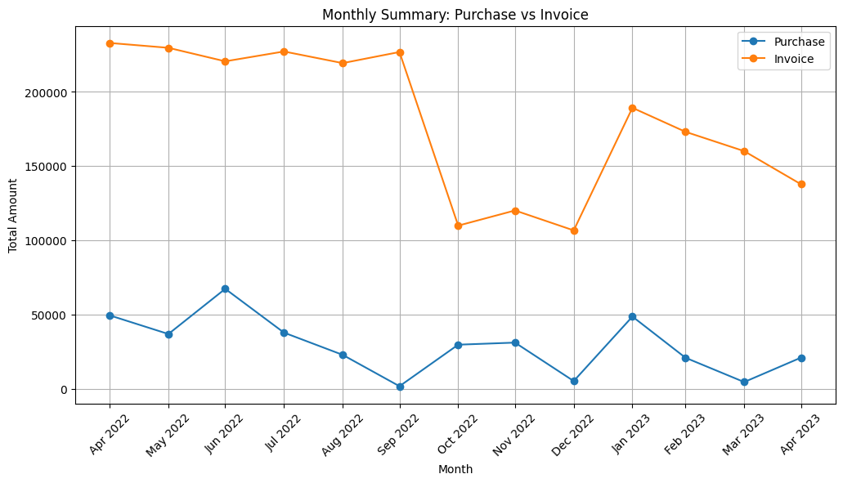
Temporal Trend Analysis
For this study, we integrated purchase and invoice data to analyse the exploration of monthly trends in profitability.
Finding the patterns and trends in profitability over distinct months, thereby highlighting periods of enhanced profitability.
How many jobs were done during the month-wise period.

Slide 6
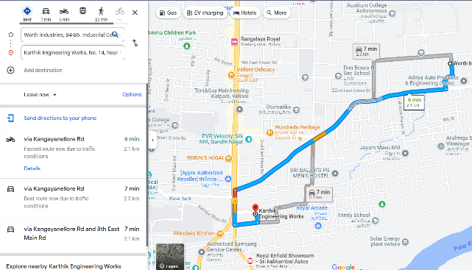
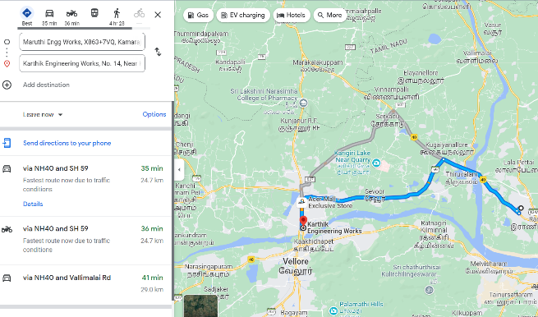
Distance Factor Analysis
The objective is to understand how geographical proximity influences the distribution of jobs.

Slide 7
Distance Factor Analysis
Proximity and Job Allocation: The analysis unveiled a significant link between geographical distance and job allocation to suppliers
Cost Influence: Additionally, cost per component played a crucial role in job allocation.
Optimizing Job Allocation: The findings emphasize favoring suppliers in closer proximity with lower costs.

Slide 8
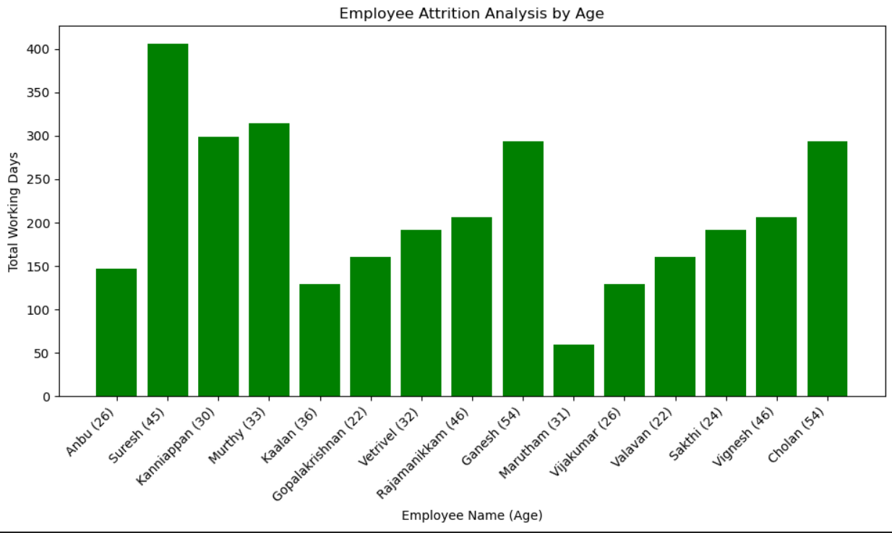
Employee Attrition Analysis The analysis of employee attrition delves into departures by examining job satisfaction, compensation, and growth opportunities.
Young employees (22 - 35) with low job satisfaction and insufficient compensation are prone to leave, while growth-oriented individuals tend to stay.
Extracted insights after analyzing employee feedback forms reveal that employees need competitive compensation.
The analysis emphasizes that workplace culture, management styles, work-life balance, and growth opportunities also shape retention dynamics intricately.

Slide 9
SWOT Analysis
Strengths
Proximity to Suppliers
Specialized Expertise
Customer Relationships
Adaptability
Weakness
Job Flow Consistency
Skilled Labor Shortage
Dependence on Specific Clients
Marketing and Branding
Opportunities
Market Diversification
Skills Development
Innovation and Technology
Partnerships and Alliances
Market Trends
Threats
Market Competition
Economic Fluctuations
Regulatory Changes
Supplier Reliability
Technological Disruption

Slide 10
RECOMMENDATIONS
Strategic Supplier Collaboration
Cost-Benefit Analysis
Supplier Relationship
Resource Optimization
Technology Adoption
Enhance Job Satisfaction
Competitive Compensation
Career Development Programs
Performance Recognition
Work-Life Balance
Exit Interviews
Employee Feedback

Slide 11
Thank you

